Slide 1
Master code camp
ETNA

Slide 2
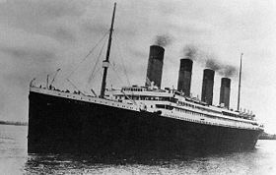
Score : 0.73206
Ranking : 4136
Titanic

Slide 3
Digit Recognizer
Score : 0.93514 Ranking : 1118

